Slide 1
Winery management
Destiny Bazan
Tyler Moon
Cassiany Noel

Slide 2
OVerview
We are a team of database developers tasked with designing a database solution for winery management, supplier relationships, wine production tracking, sales reporting, and employee management to optimize operations.

Slide 3

Brief Description of the Case Study
The case study revolves around developing a database system for a winery, which requires efficient tracking and management of various entities such as:
• Suppliers
• Wine production and inventory
• Distribution and sales reports
• Employee hours and departmental management
The goal is to create a relational database that maintains data integrity while providing reports to aid operational decision-making.

Slide 4
Finalized Entity-Relationship Diagram (ERD)

Slide 5
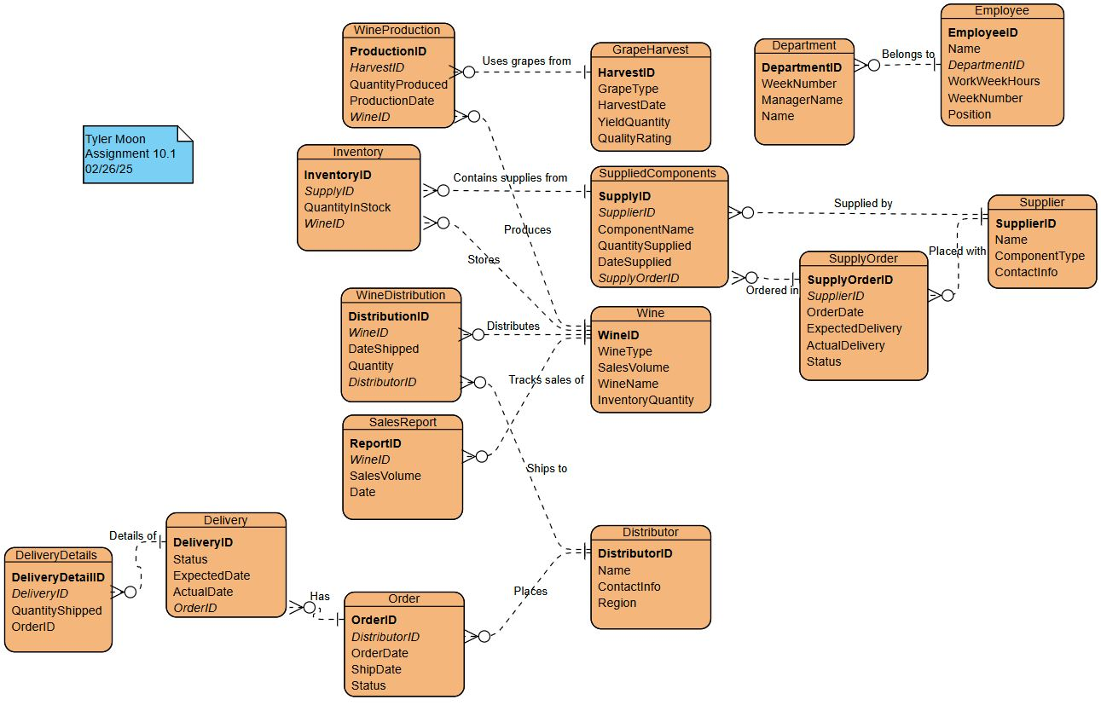

Slide 6
Reports to generate
Supplier Performance Report
Wine Sales by Type and Distributor
Employee Hour Reports

Slide 7
Supplier Performance Report:
Supplier: Supplier A, Order Date: 2024-09-01, Expected Delivery: 2024-09-10, Actual Delivery: 2024-09-09, Delivery Difference: -1 days
Supplier: Supplier B, Order Date: 2024-09-05, Expected Delivery: 2024-09-12, Actual Delivery: 2024-09-12, Delivery Difference: 0 days
Supplier: Supplier C, Order Date: 2024-09-07, Expected Delivery: 2024-09-14, Actual Delivery: 2024-09-13, Delivery Difference: -1 days
Supplier: Supplier C, Order Date: 2024-09-07, Expected Delivery: 2024-09-14, Actual Delivery: 2024-09-13, Delivery Difference: -1 days
Supplier: Supplier A, Order Date: 2024-09-04, Expected Delivery: 2024-09-16, Actual Delivery: 2024-09-15, Delivery Difference: -1 days
Supplier: Supplier C, Order Date: 2024-09-06, Expected Delivery: 2024-09-20, Actual Delivery: 2024-09-19, Delivery Difference: -1 days

Slide 8
Wine Sales by Type ane Distributor
Wine: Merlot Reserve, Type: Red, Distributor: Distributor One, Total Sales: 1050
Wine: Merlot Reserve, Type: Red, Distributor: Distributor Five, Total Sales: 1050
Wine: Cabernet Estate, Type: Red, Distributor: Distributor Two, Total Sales: 850
Wine: Cabernet Estate, Type: Red, Distributor: Distributor Six, Total Sales: 850
Wine: Chablis Premium, Type: White, Distributor: Distributor Three, Total Sales: 350
Wine: Chardonnay Classic, Type: White, Distributor: Distributor Four, Total Sales: 250
Type: Red, Wine: Merlot Reserve, Total Sales: 1050
Type: White, Wine: Chablis Premium, Total Sales: 350
Worst Selling Wines by Type:
Type: Red, Wine: Cabernet Estate, Total Sales: 850
Type: White, Wine: Chardonnay Classic, Total Sales: 250

Slide 9

Employee hours report
Employee: Janet Collins, Total Hours Worked: 40 hours
Employee: Roz Murphy, Total Hours Worked: 37 hours
Employee: Bob Ulrich, Total Hours Worked: 50 hours
Employee: Henry Doyle, Total Hours Worked: 40 hours
Employee: Maria Costanza, Total Hours Worked: 40 hours
Employee: John Smith, Total Hours Worked: 40 hours

Slide 10
Assumptions Made about the case study​
Supplier Reliability:
Supplier lead times are important to operations the business needs to track each supplier. The Supplier Performance Report will help assess trends in delivery reliability.
Inventory Management:
Each supply order be tracked and logged upon arrival or during processing failure that could affect inventory levels and the reporting process.
Delivery Delays:
Delays are categorized as significant, and the system should flag these instances for managerial review. Any delivery delay is assumed to impact production timelines, especially during harvest and wine production.
Wine Production Rates:
The production process is consistent based on the harvest and materials supplied. However, seasonal changes or unexpected supply issues may disrupt production volumes the winery need to track production.
Wine Type Popularity:
Different wine types have different market demand patterns. The winery need to manage production of top selling products while maintaining lower sales items.

Slide 11
Assumptions Made about the case study​ (cont'd)
Stock Levels:
Wine inventory is assumed to be continuously updated through sales data. Wine in inventory will rotate based on expiration dates, so older wine is sold first.
Sales Fluctuations:
Assumes that sales volume fluctuations are normal, with peak seasons in certain months (e.g., holidays). The Wine Sales Report will adjust for these fluctuations to track distributor performance and identify any supply-demand mismatches
Distributor Performance:
Assumes distributors are the primary sales channel for Bacchus Winery's products. Performance reports will be evaluated based on their order volume, delivery frequency, and their ability to manage stock levels at retail.
Sales Volume Predictions:
Sales volumes may be affected by external factors like economic conditions or market trends, but for the sake of simplicity, we assume that wine sales align with typical growth trends over time.
Distributor Partnerships:
Assumes that each distributor works with exclusive products. This helps simplify tracking and reporting since each distributor is associated with a specific set of wines.

Slide 12
Assumptions Made about the case study​ (cont'd)
Workforce Composition:
Eemployees are full-time with varying job roles across departments, such as production, sales, and administration, recorded over a fiscal week system, helping to identify overtime or under-utilization.
Department-Specific Hours:
Departments may have different work patterns, the system must be flexible enough to report on hours by both individual employees and departments.
Data Consistency:
Data integrity is critical; employees entering data follow established guidelines for consistency and accuracy.
Reporting Frequency:
Reports are assumed to be generated quarterly or annually; the management team evaluates performance and makes strategic decisions based on periodic data, not real-time.
System Flexibility:
The system assumes that it can be scaled in the future if Bacchus Winery expands its operations or product offerings. The Employee Hours Report, for example, can accommodate the growing workforce, and the Wine Sales Report can include additional wine types or new distributors.

Slide 13
Conclusion
In summary, the case study solution for Bacchus Winery provides a robust framework to manage and track various aspects of the business, including supplier performance, wine production, sales, and employee work hours. Reports, such as the Supplier Performance Report, Wine Sales Report, and Employee Hours Report, provide the necessary tools to identify areas for improvement and make data-driven decisions that align with business objectives.

Slide 14
THANK YOU
CSD_310

